Slide 1
Personality Adjectives
Basic 4 – Unit 12a

Slide 2
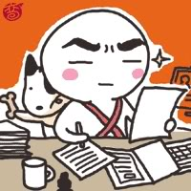
What is he like?
He is serious and hardworking

Slide 3
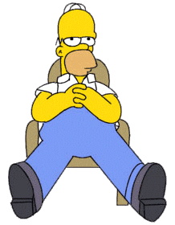
What is he like?
He is lazy.
He is not hardworking

Slide 4
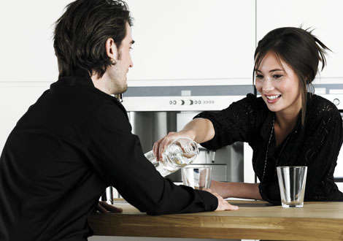
What is she like?
She is outgoing because she is very friendly and extrovert.
She is not shy

Slide 5

What is he like?
He is very shy.
He is not outgoing because he is very timid

Slide 6
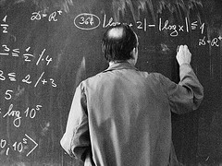
What is he like?
He is very smart.
He is very intelligent

Slide 7
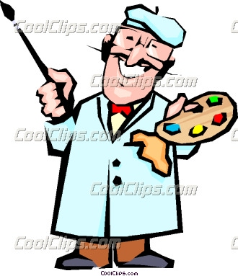
What is he like?
He is creative.
He likes painting and he has a good imagination

Slide 8
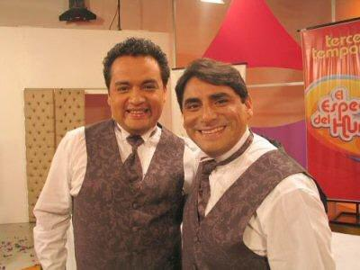
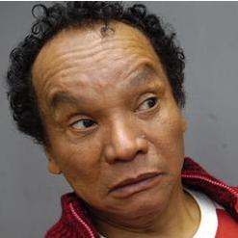
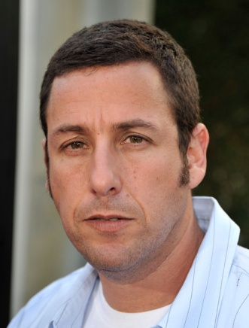
What are they like?
They are funny.
People always laugh at their jokes.

